Slide 1

Databases
BSc Honors Software Engineering

Slide 2
Introduction
In our Library Service System, there is one main library which contains 4 different branches based on the popularity of books available.
Academic Library
Public Library
School Library
Special Library
In the main library, you are allowed to register any member. Memebers are under 5 categories. They are –
Kindergarten Kids
Students
Undergraduate
Postgraduate
Others

Slide 3
Introduction
Under Employees, there are 9 main positions in our Library Service System –
Librarian
Director
Medical librarian
Media specialist
Clerk
Assistant
Library aid
Archivist
For the employee entity, there is a multivalued attribute called Qualification.
Publisher details are recorded for each book too.

Slide 4
Introduction
When a member borrows a book, issue date, due date and return date is recorded.

Slide 5
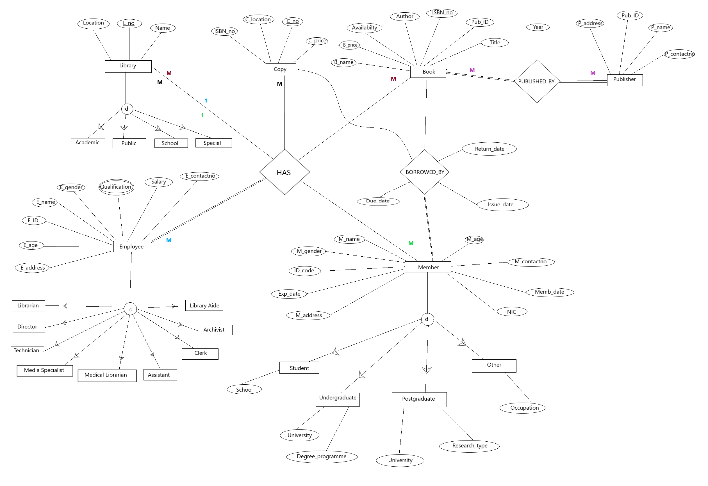
Extended entity Relationship diagram

Slide 6
Tables
Library
Library Location
Academic
Public
Special
Employee
Emp_Qualifications
Librarian
Director
Media Specialist
Assistant
Library Aid
Archivist

Slide 7
Tables
Publisher
Book
Availability
Member
Student
Copy
CopyLocation
HasRelationship
Bo

Slide 8
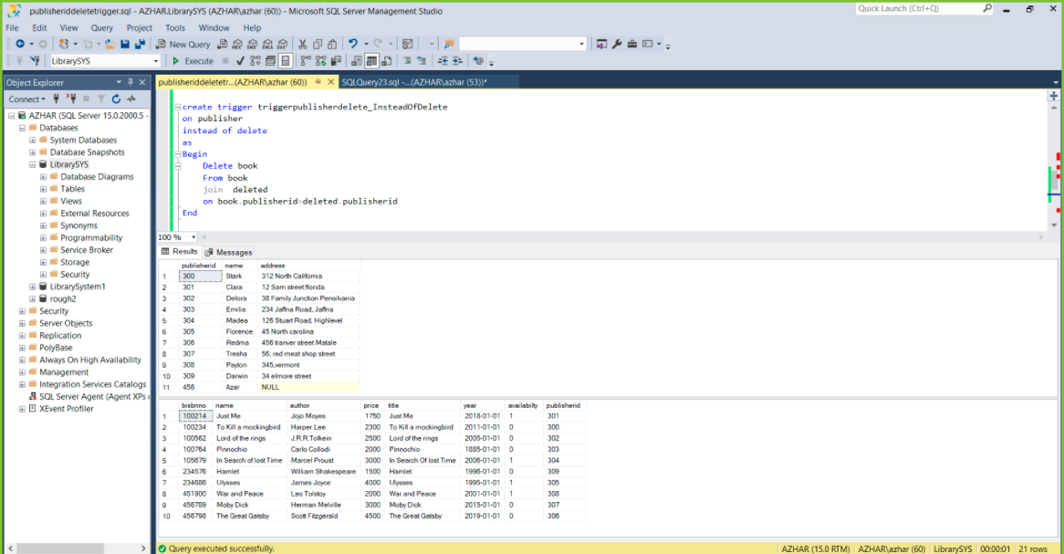
triggers

Slide 9
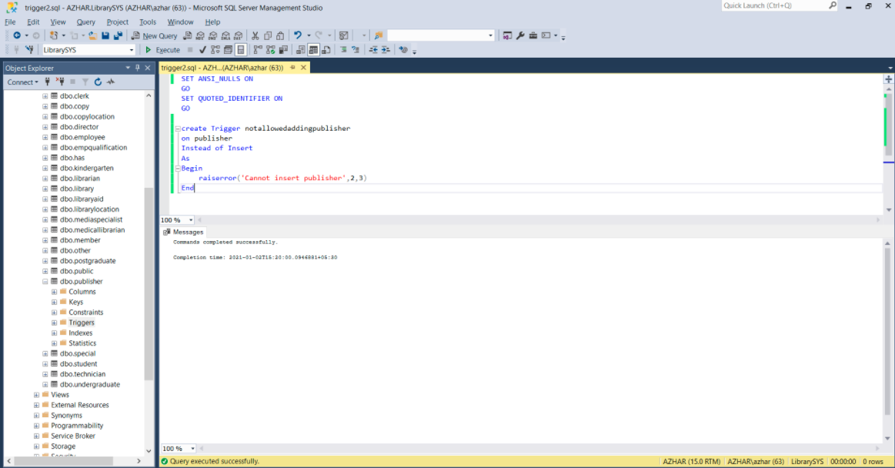
triggers

Slide 10
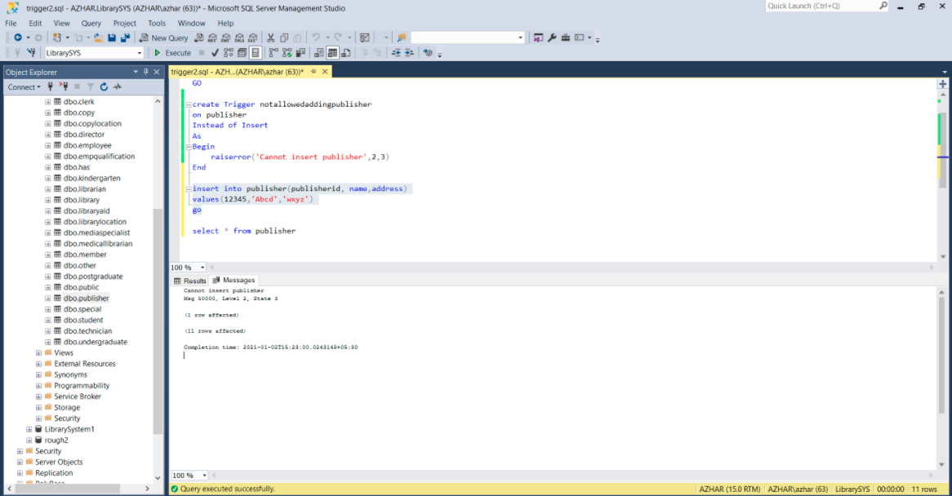
triggers

Slide 11
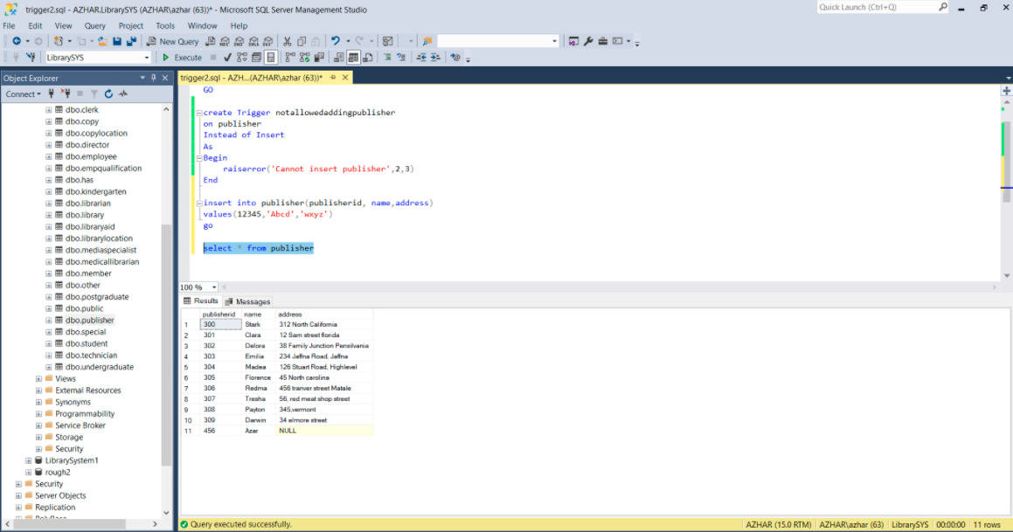
triggers

Slide 12
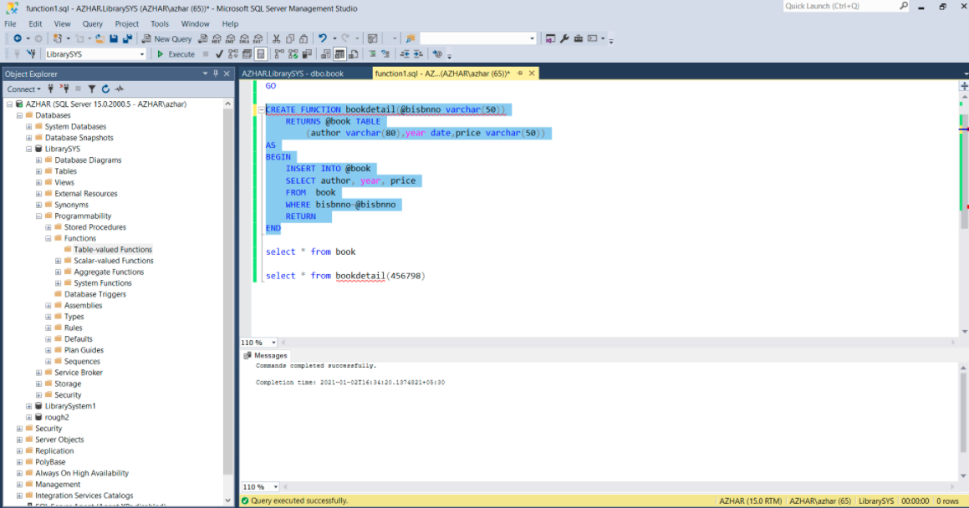
Function

Slide 13
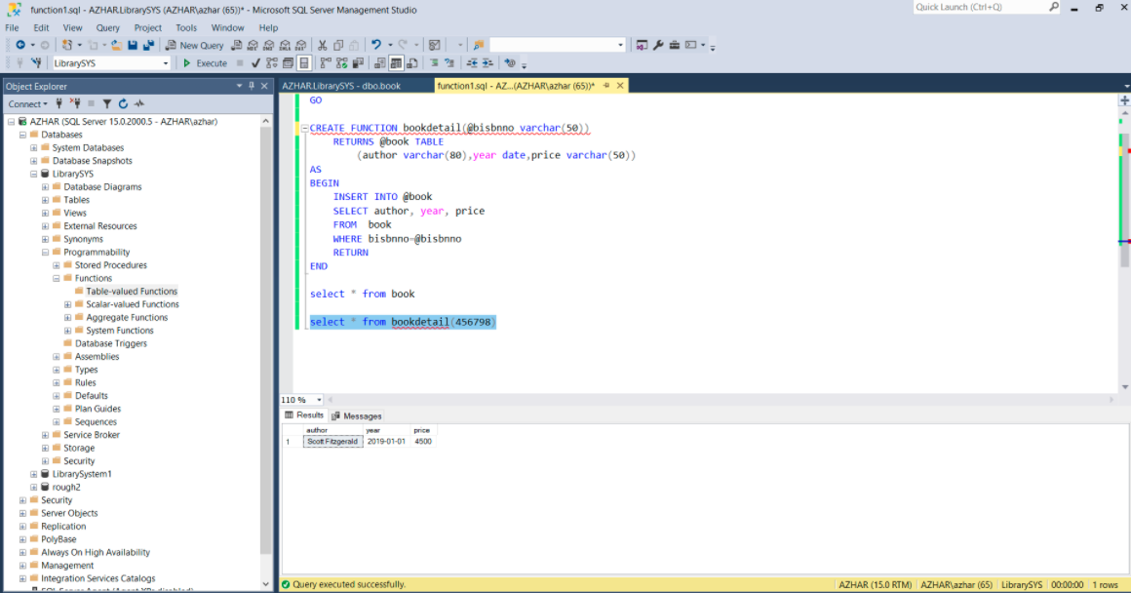
Function

Slide 14
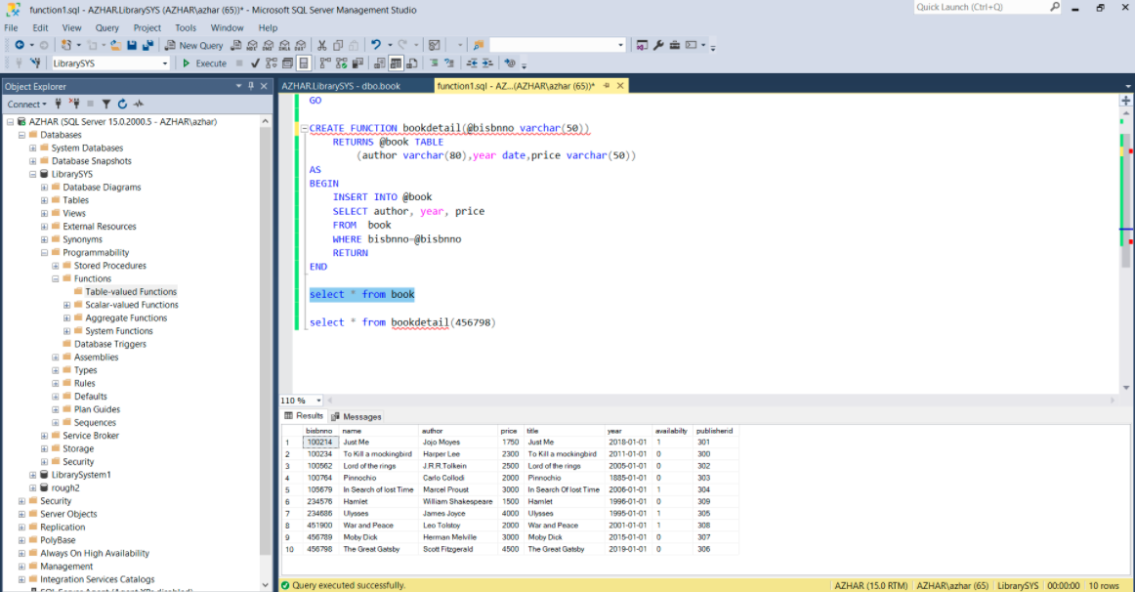
Function

Slide 15
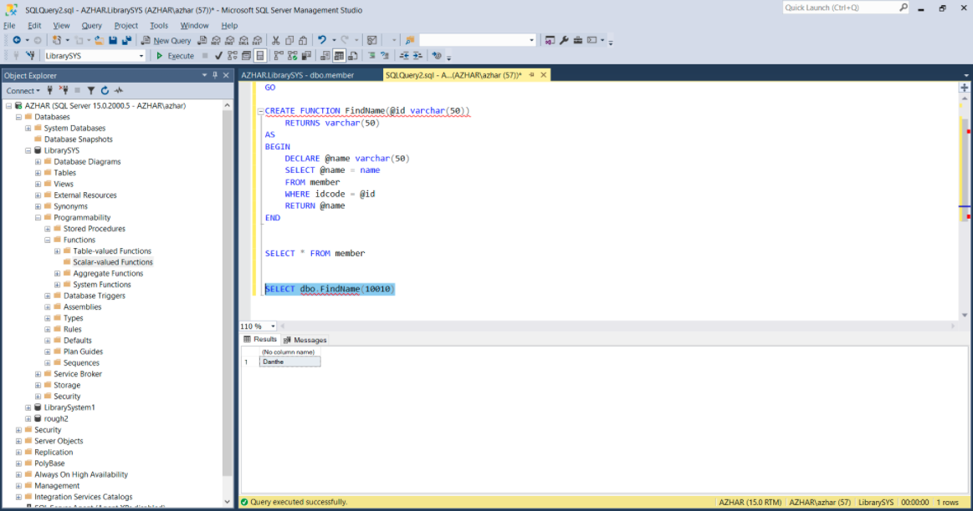
Function

Slide 16
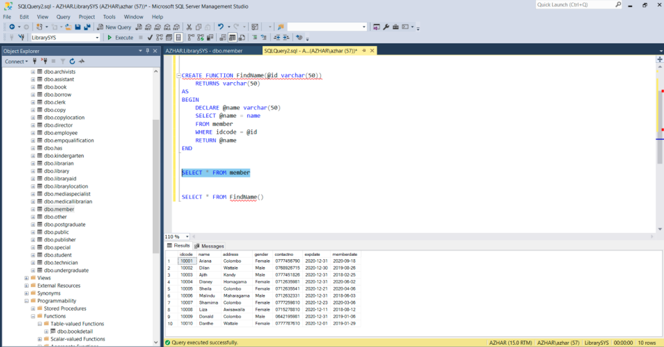
Function

Slide 17
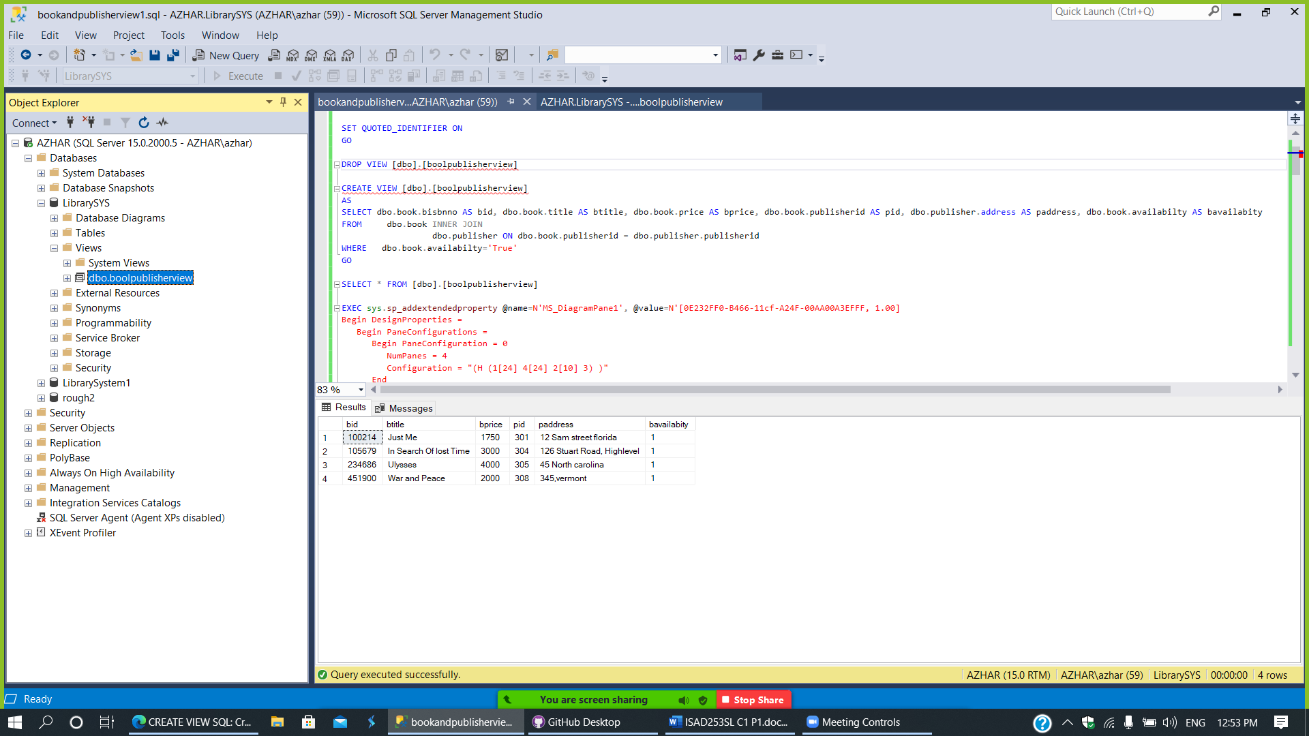
View

Slide 18
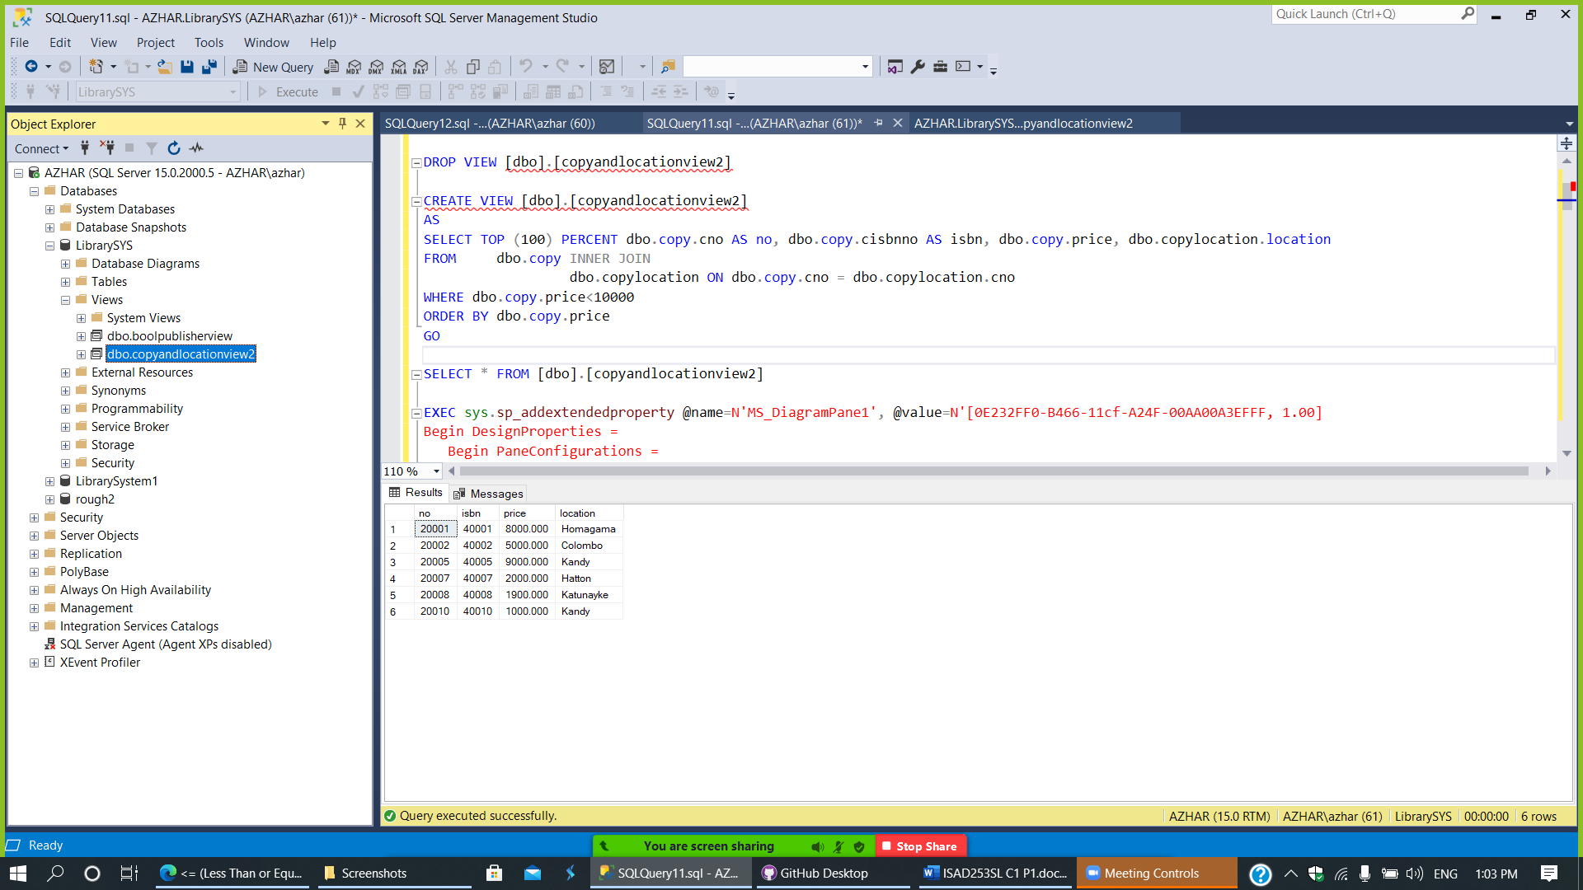
view

Slide 19
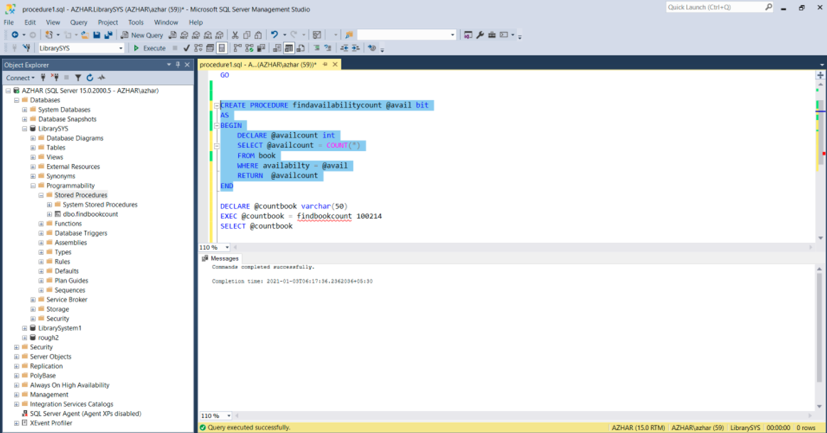
Procedure

Slide 20
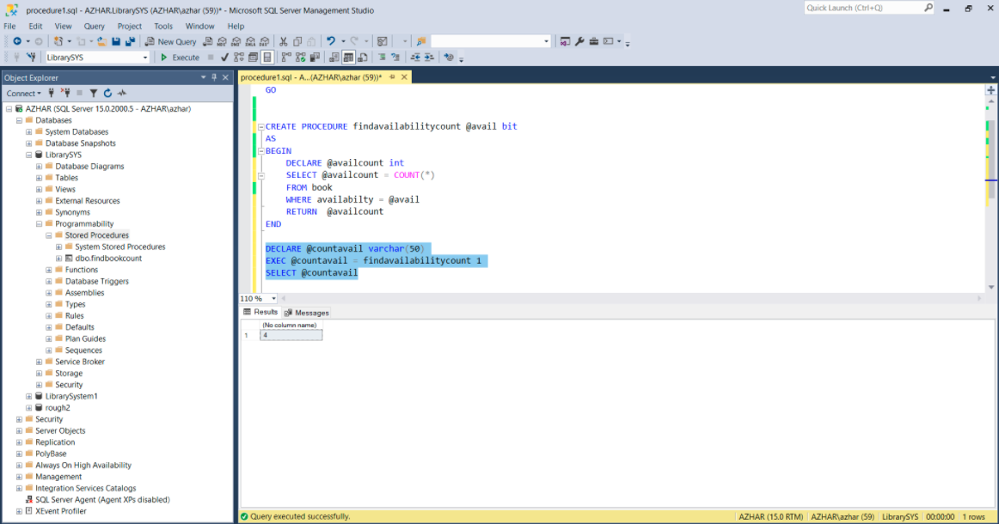
Procedure

Slide 21
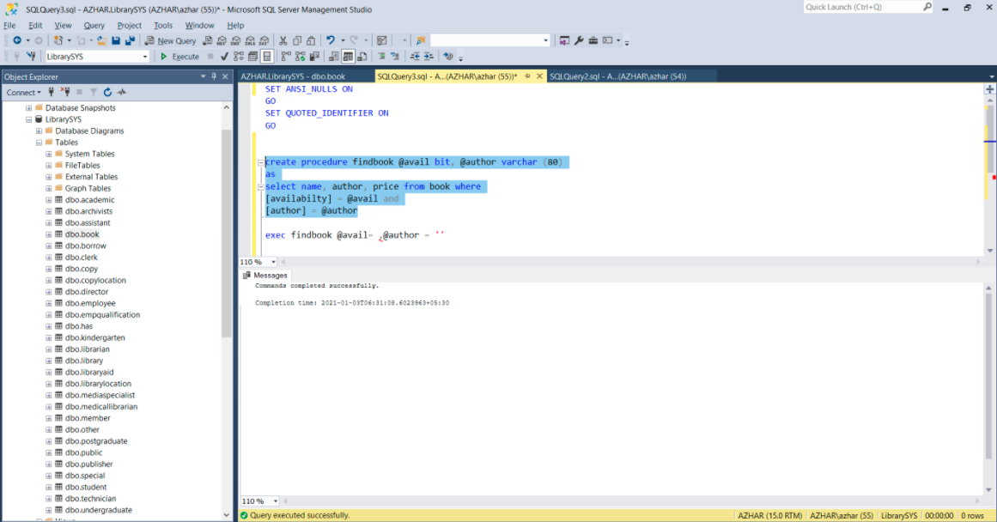
Procedure

Slide 22
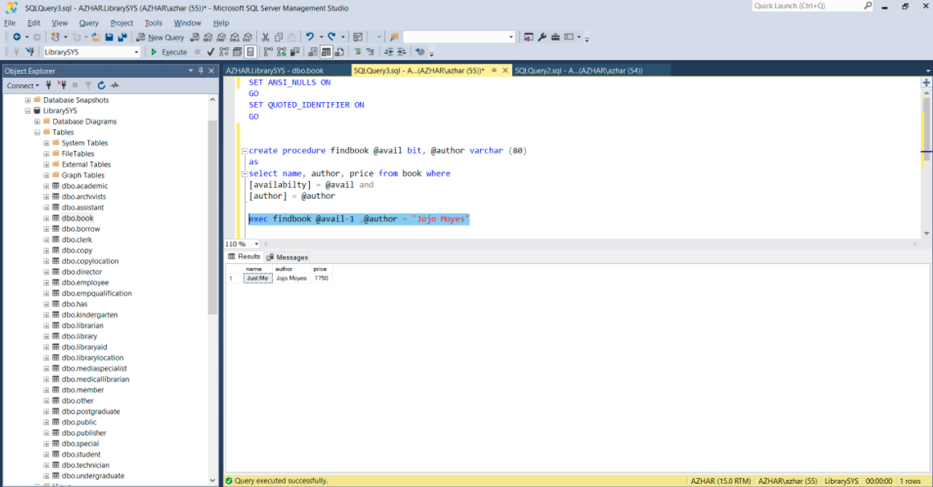
Procedure

Slide 23
Conclusion
Sri Lankan public libraries still track books by hand, where they use a card system. This can be exhausting and slow. These libraries can definitely benefit from this application that we have made if they implement it. They will save time, increase efficiency and have less paperwork.

Slide 24
Members in the group
1.Nethma-10707
2.S.S.N.S.Nevins-10707291
3.J.A.Mujeeb-10707
4.S.O.Perera-10707315
5.G.M.D.D.Ratnayake10707351

